Slide 1
Autonomous Navigation and Data Acquisition Systems
Group : 6
S.Vikhyath (S20180020243)
Siddanathi Hemanth Kumar (S20180020245)

Slide 2
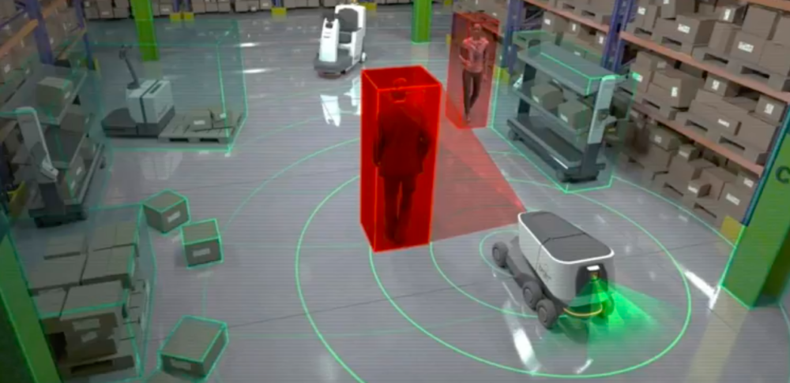
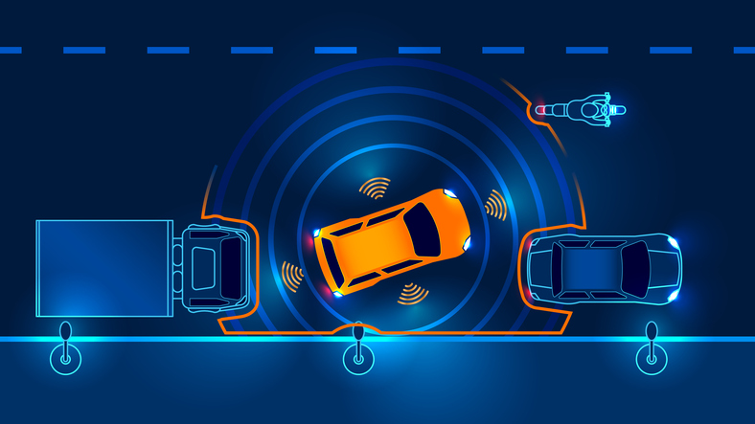
Introduction
Autonomous Navigation :
Autonomous navigation enables a vehicle or a robot
to plan its path and execute its plan without human
intervention.
Autonomous navigation lies at the heart of autonomous
robots and vehicles, and involves a multi-disciplinary
approach.
It includes a variety of topics such as
Sensor technologies
Behaviour modelling
Trajectory prediction
Localization and mapping methods
Path planning in the presence of obstacles etc.
Image Source : 1) https://www.therobotreport.com/autonomous-navigation-design-challenges/
2) https://www.visiononline.org/blog-article.cfm/Embedded-Sensing-Layers-for-Autonomous-Navigation/114

Slide 3
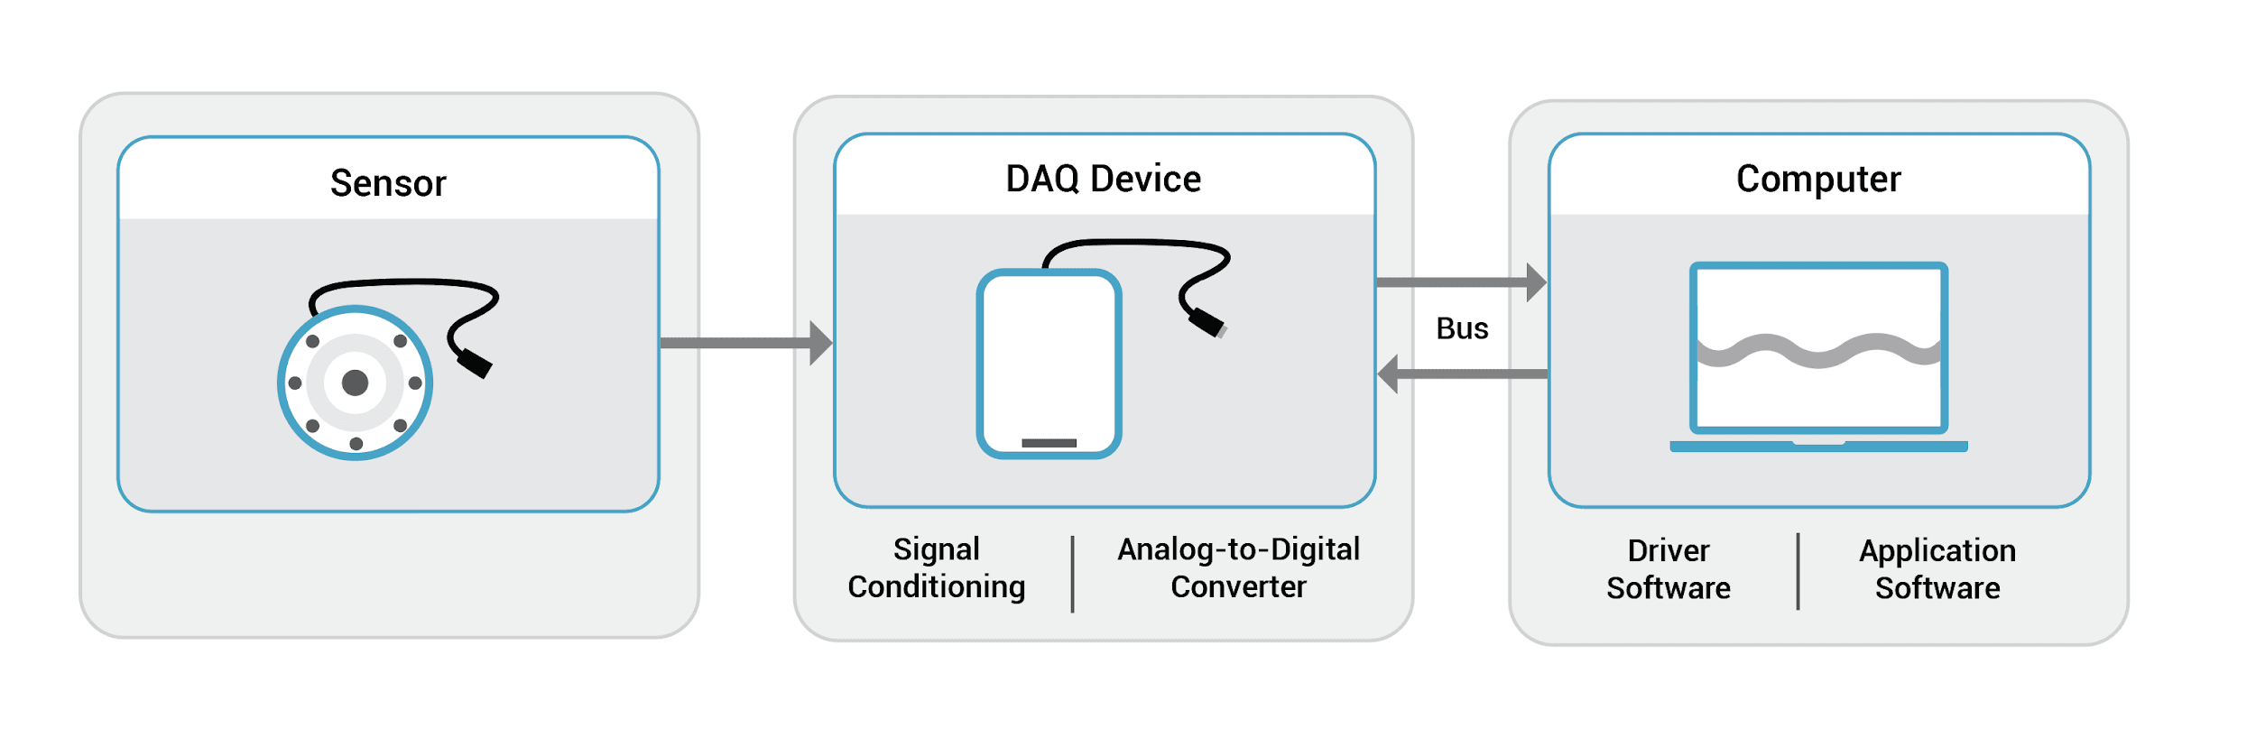
Introduction
Data Acquisition Systems :
Data acquisition is a process where raw data from the physical world are collected, processed, stored and used.
The raw data is converted into digital numeric values so that they can be manipulated by a computer.
Data Acquisition System interfaces between the sensor and a computer running the DAQ software.
Image Source : https://www.ni.com/en-in/shop/data-acquisition.html

Slide 4
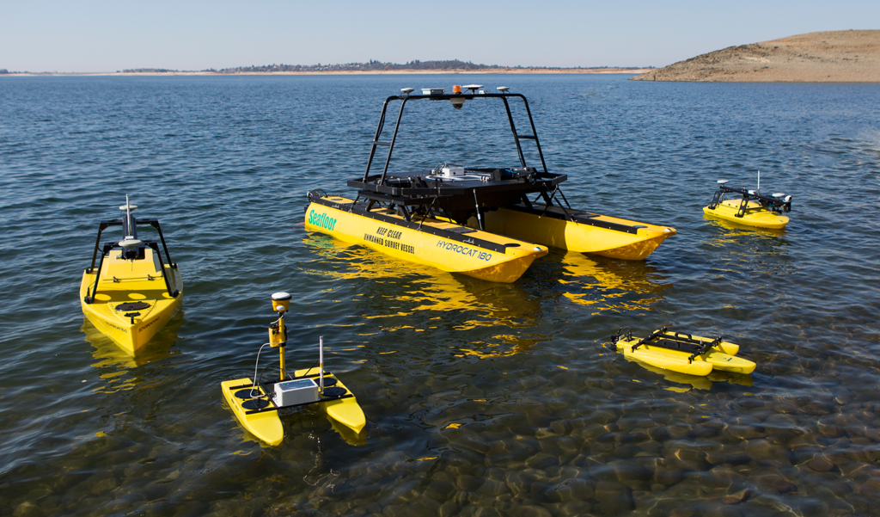
Importance and Technological Advancements
Autonomous Navigation :
At first, autonomous navigation was based on planar sensors, such as laser range-finders, that can only sense at one level.
Sensors such as camera, RADAR and LiDAR are used in current generation autonomous navigation systems.
They help the system detect the speed, distance and 3d shape of the surroundings and nearby objects.
Autonomous Navigation is used in :
Unmanned Aerial Vehicles (UAV)
Autonomous Surface Vehicles (ASV)
Self-driving/Autonomous cars
Autonomous Underwater Vehicles (AUV) etc.
Image Source : https://www.unmannedsystemstechnology.com/company/seafloor-systems/

Slide 5
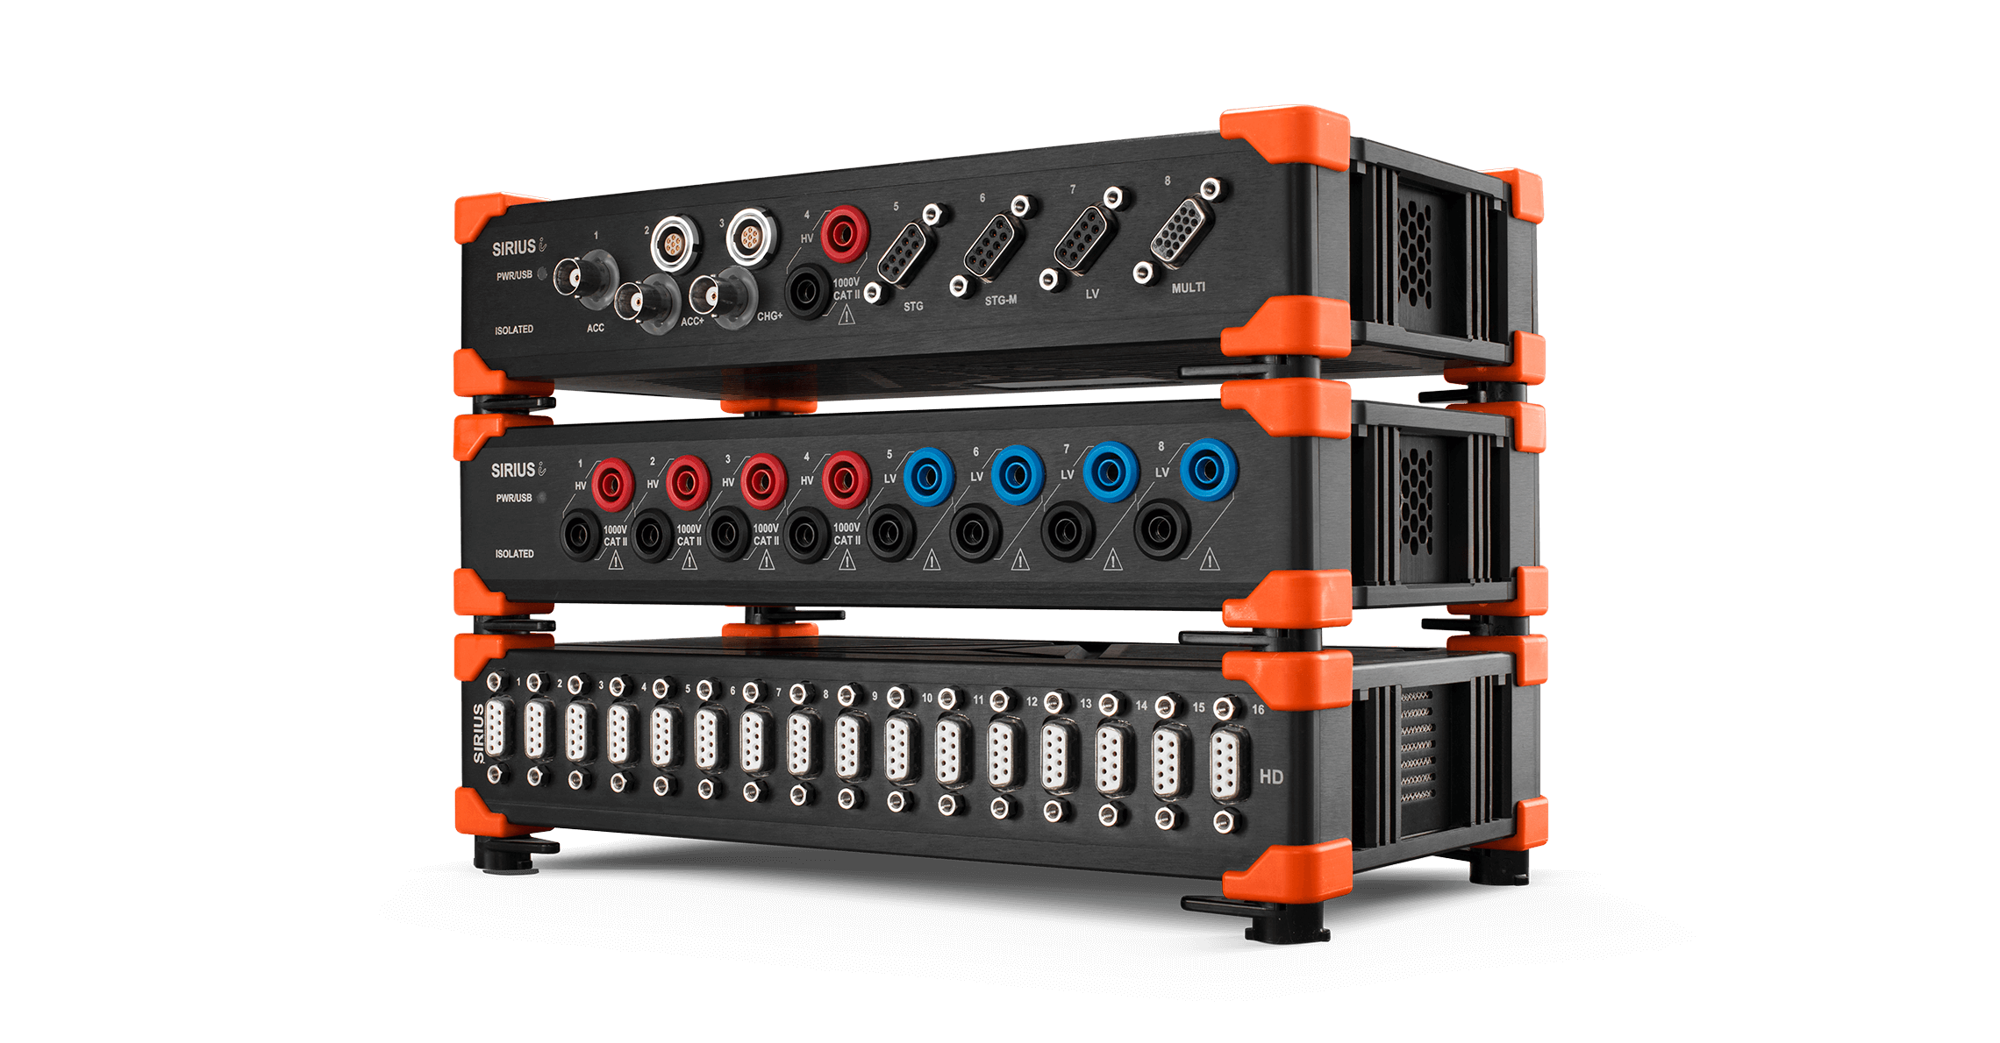
Importance and Technological Advancements
Data Acquisition Systems :
The concept of DAQ was introduced in 1963.
IBM was the first to announce a computer that was solely made for DAQ tasks called the IBM 7700 DAQ system.
They play a key role in digitizing the sensor data in a cyber physical system.
Development of more affordable sensors and better DAQ systems resulted in Big Data.
Advances in USB technology made DAQ and storage more efficient.
DAQ systems are used in :
Aerospace applications
Aircrafts
Biomedical applications
Test & Measurement Applications
Refer http://www.gage-applied.com/data-acquisition/applications/index.htm for more info on applications.
Image Source : https://dewesoft.com/products/daq-systems/sirius

Slide 6
Challenges
Autonomous Navigation :
Getting the software right.
Gathering enough Real-world data.
Creating highly accurate motion control.
Processing power.
Amount of storage.
Inability to re-configure a Data Acquisition System.
Data Acquisition Systems :

Slide 7
THANK YOU

